Slide 1
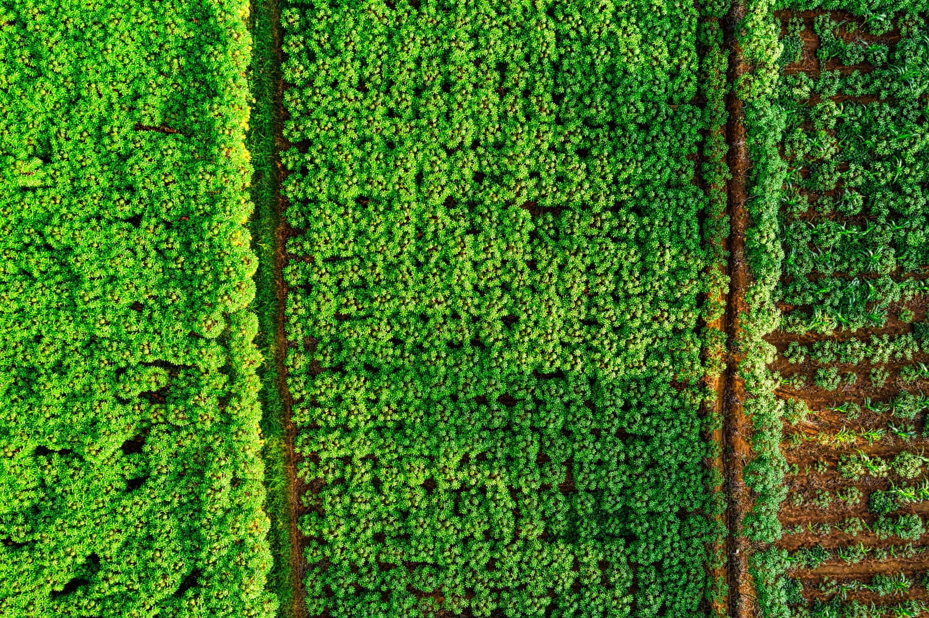
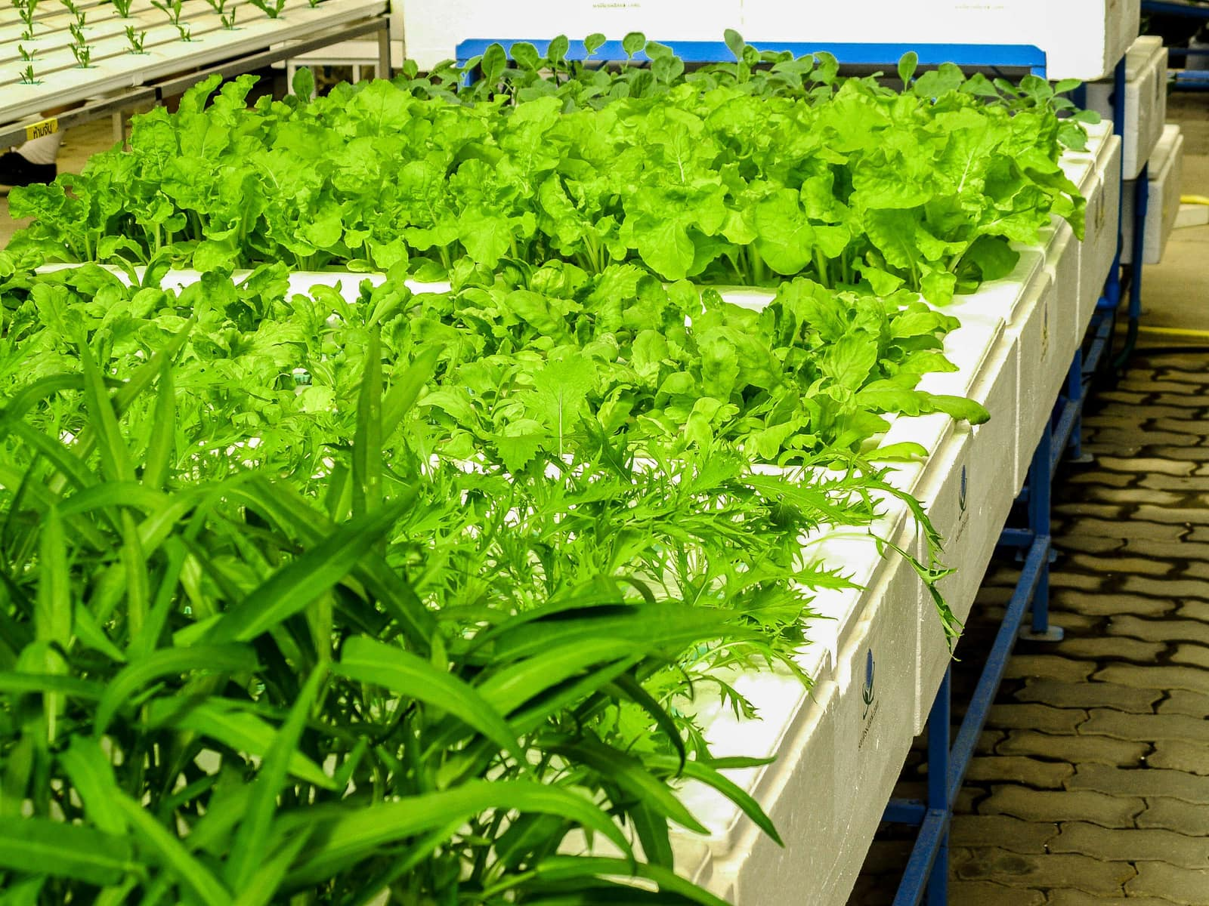
Intelligent Farm Operations Platform
with smart agro precision system
PRESENTED BY:
Likith Kumar Reddy
Sadhana
Prem Narayan N L
Arpitha B N
MENTOR :
Suramya Biswas

Slide 2

INTRODUCTION
  Agriculture supports human life through food, raw materials, and livelihoods, but traditional farming often relies on manual decisions and resource estimation.
  IntelligentFarmOperationPlatform integrates technology, data, and AI to make farm management smarter and more efficient.
Transforming traditional farming into a smarter, data-driven & resource-efficient agricultural system.

Slide 3
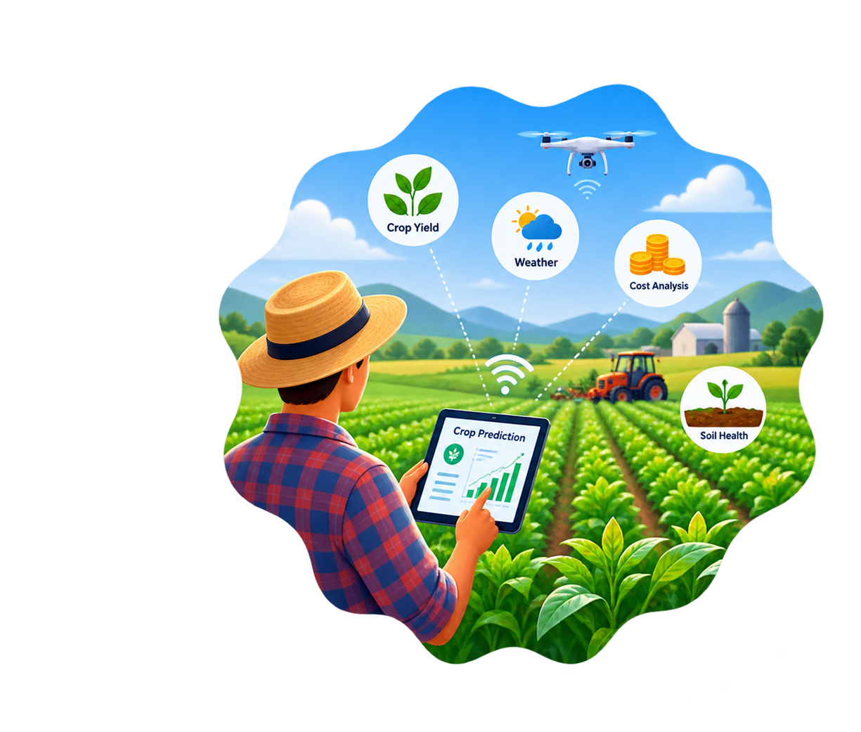
PROBLEM STATEMENT
  Traditional farming relies on manual estimation and fragmented farm, crop, and expense management.
  Farmers need centralized, data-driven yield prediction and resource planning.
Problem requires a integrating farm management, AI-powered yield prediction & resource planning.

Slide 4
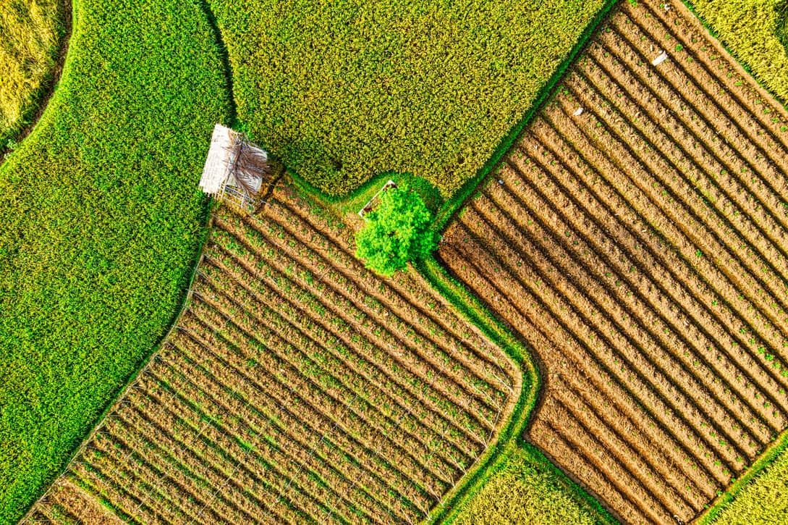
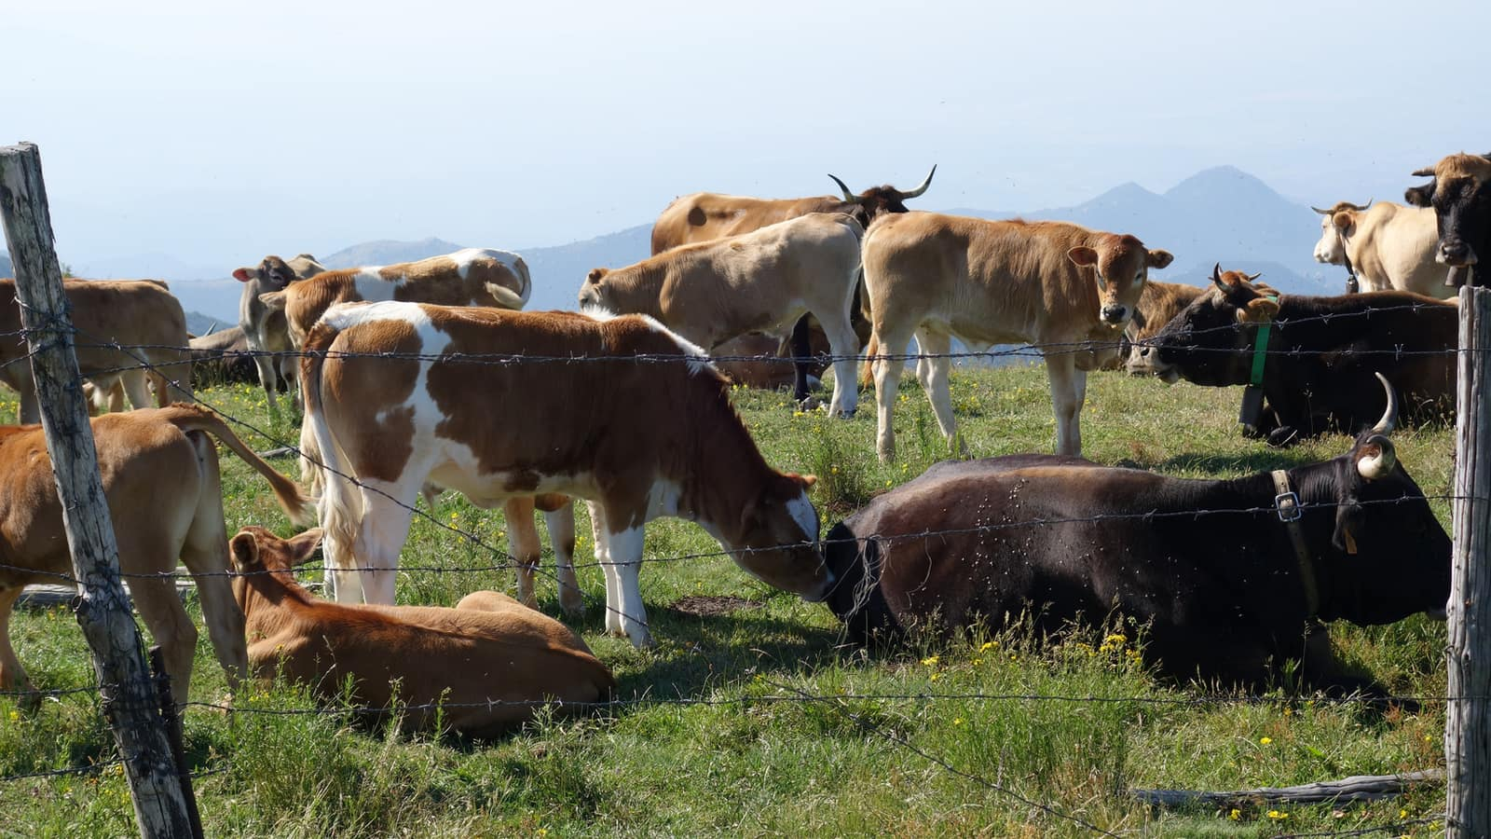
PROPOSED SOLUTION
A smart platform integrating farm management, AI prediction, resource planning, and expense tracking.
Farm Management
AI & Resource Planning
Manage multiple farms and their agricultural details in one centralized system.
Use AI-powered predictions to support better cultivation planning..
Why this Solution?
  Store area, location, and soil information.
  Manage crops cultivated in each farm
  Estimate water, fertilizer requirements etc
  Recommend fertilizer and pesticide quantities
Helps farmers use crop data to estimate yield and plan required resources.

Slide 5

OBJECTIVE OF THE PROJECT
Smart Farm Management
Precision Resource Planning
Centralize farm and crop details for efficient and organized agricultural management.
Predict essential water, fertilizer, pesticide, and tractor requirements for efficient resource planning.
Expense Management
AI-Based Yield Prediction
Use AI to predict crop yield from soil, area, and cultivation details for better planning.
Calculate cultivation expenses using predicted resource requirements and unit prices

Slide 6

TECH STACK
1. Backend Technologies
2. Frontend Technologies
Java 21 • Spring Boot 3.5.4
Used for developing the core application logic, REST APIs, and backend services.
React 19.2.7 • Bootstrap 5.3 • React Router
Used to build the responsive, interactive, and user-friendly web interface.
The platform combines modern full-stack, database, security, and AI technologies to provide a reliable and intelligent solution for farm operations.
3. Database & Security
4. AI & Communication
PostgreSQL • Spring Data JPA • Spring Security
Used for structured data storage, database management, authentication.
Hugging Face • Axios
hugging face provides AI-powered agricultural predictions, while Axios handles API communication.

Slide 7
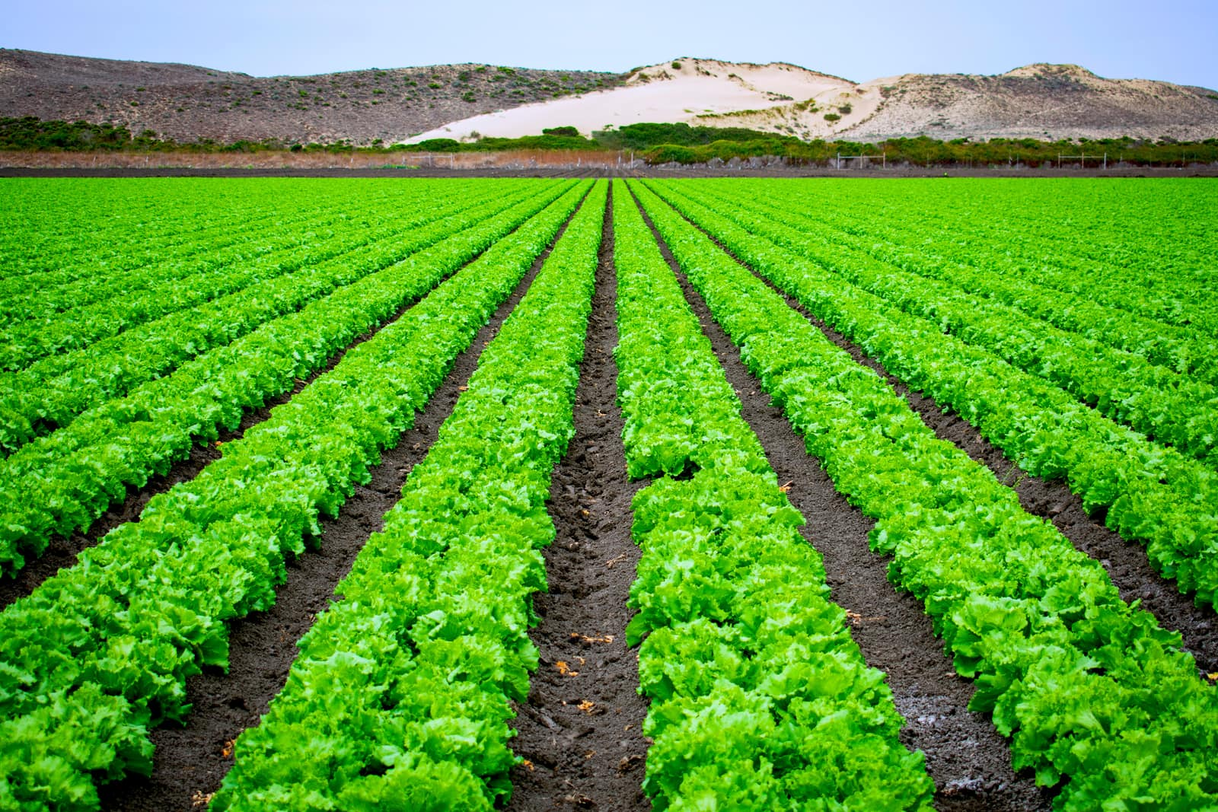
Implementation Road Map
1. Farm & Crop Management
Implement farmer authentication and manage farm and crop details, including area, soil, location, sowing, and harvest periods.
2. AI-Based Precision Planning
Integrate AI services to predict crop yield and required water, fertilizer, pesticides, and tractor hours.
3. Expense & Report Generation
Calculate crop-wise expenses from predicted resources and unit prices, then generate the Farm Crop Report.

Slide 8
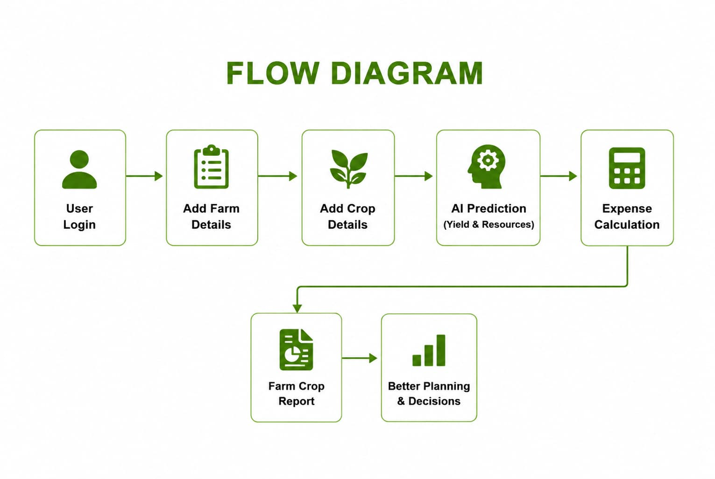

Slide 9
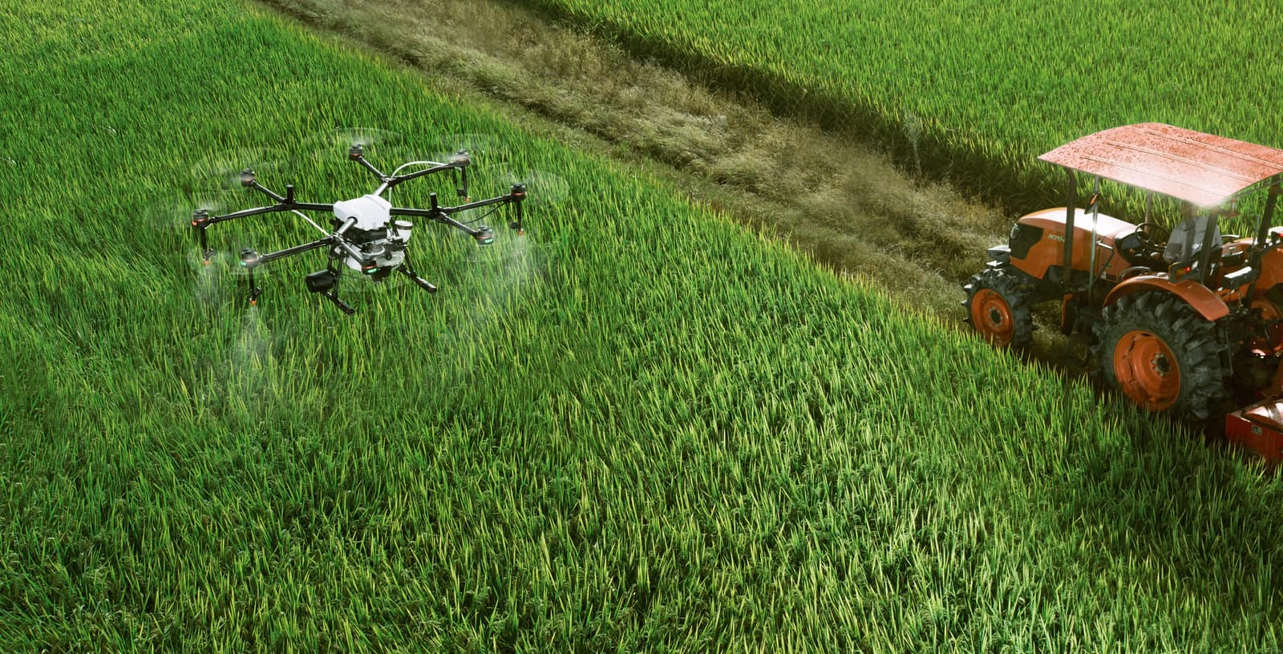
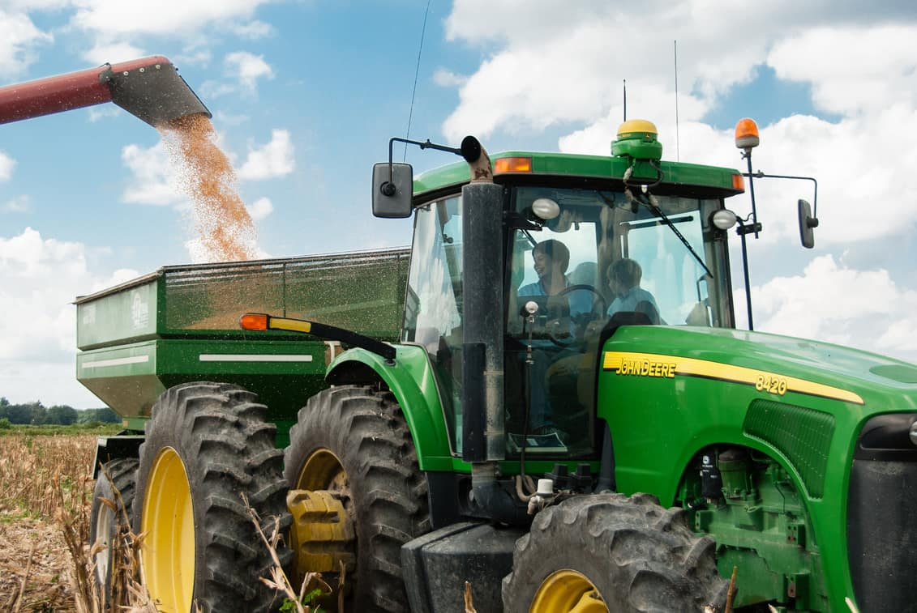
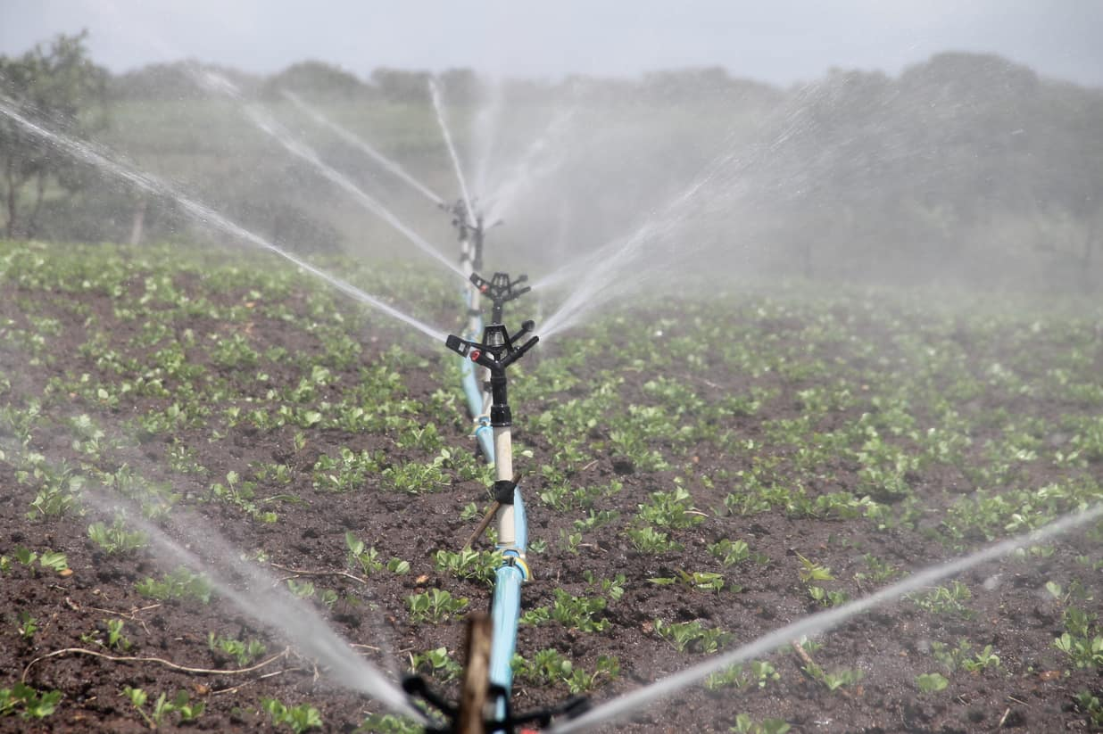
IMPACTS AND BENEFITS
Smart Farm Management
Resource Optimization
Improved Financial Planning
Centralizes farm, crop, resource, and expense data for easier agricultural management.
AI predicts key resource requirements, helping reduce waste and improve resource efficiency.
Provides crop-wise cost estimates for better budgeting and informed cultivation decisions.

Slide 10
FUTURE SCOPE
Can be expanded with advanced technologies for more accurate and intelligent agricultural decision-making.
IoT & Smart Sensors
Weather & Crop Analytics
Satellite & Drone Monitoring
Mobile & Intelligent Farming
Integrate soil moisture, temperature, and weather sensors for real-time field monitoring.
Use weather and crop data to improve yield prediction and planning.
Use satellite imagery and drones to monitor crop health and support precision agriculture.
Extend the platform to mobile devices with AI-powered field management and alerts.

Slide 11
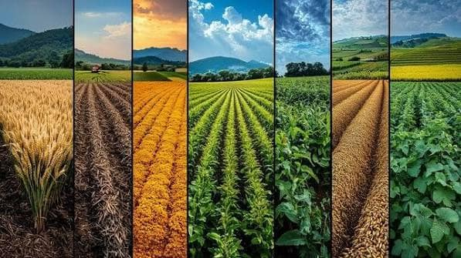
Conclusion:
Combines farm management, AI prediction, resource planning, and expense analysis for smarter, sustainable farming.
Outcomes:
  Accurate Crop Yield Prediction: Helps farmers estimate crop production using AI-based analysis.
  Efficient Resource & Cost Management: Supports better planning of water, fertilizer, pesticides, and tractor usage.
  Smarter Farming Decisions: Provides integrated farm and crop insights for efficient agricultural planning.

Slide 12

INTELLIGENT FARM OPERATION PLATFORM
Thank You!
Grow with Purpose

